Slide 1




Name : TanWei Qin
edX: Tan_Wei_Qin
GitHub: WhiteApple888
Location: Singapore
Date: 29th Nov 2025
cleanIVENT
Hospital Intervention Data Cleaning Pipeline in R

Slide 2



Introduction
Senior Pharmacist
Tan Tock Seng Hospital
Singapore

Slide 3







1
“cleanIVENT”
Hospital Intervention Data
Cleaning Pipeline in R
PROBLEM STATMENT
2
PROJECT OVERVIEW
3
CONTENTS
LIVE DEMO
4
WHAT I LEARNT IN R
5
POTENTIAL TIME SAVINGS

Slide 4


1
  Problem Statement
Extensive list of pharmacy intervention documentation (i-vents)
Data standardization, cleaning and de-identification are prequisite steps for AI to perform classification
Manual manipulation of rows and columns in spreadsheets
High Time Sink (~45 mins per month) with tight deadlines, often have to be completed on personal, non-work time.

Slide 5

2:
  Project overview:
  “cleanIVENT” package
Product: 4 CSV files for AI classification and subsequent cleanups.
Step 3: Pipe to split_for_ai(df2) function
.
Step 1: PROMPT USER CSV FILE NAME AND MMM-YY
Step 2: Auto-executes load_and_clean (file, MMMYY) function
step 4: Pipe to export_results (df2, list, MMMYY, prefix =”ivent”) function

Slide 6
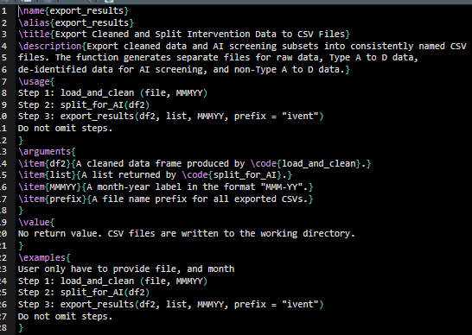
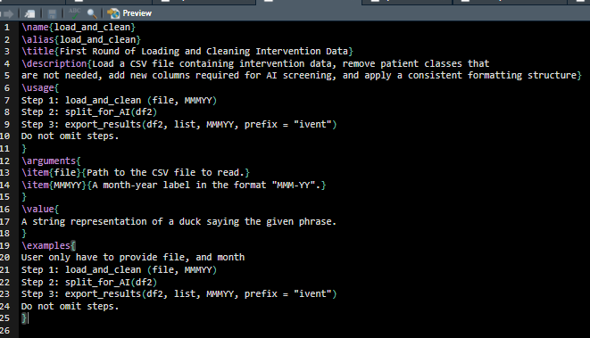
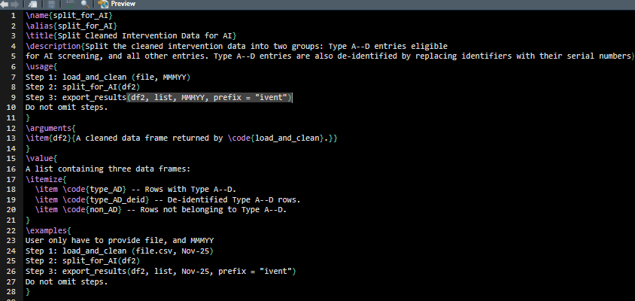
2:
  Project Overview
load_and_clean - returns a dataframe (df2)
Load a CSV file containing intervention data, remove patient classes that are not needed, add new columns required for AI screening, and apply a consistent formatting structure
export_results - no returns
Export cleaned data and AI screening subsets into consistently named CSV files. The function generates separate files for raw data, Type A to D data, de-identified data for AI screening, and non-Type A to D data..
split_for_ai - returns a list
Split the cleaned intervention data into two groups:
1) Type A to D entries eligible for AI screening
2) all other entries for manual processing
Type A to D entries are also de-identified by replacing identifiers with their serial numbers

Slide 7
3
  LIVE DEMO
R script
load_and_clean
split_for_ai
export_results

Slide 8

  Impact
4
Immediate Time Savings: ~ 45 mins/mth
Potentially higher savings when we automate more manual steps down the pipeline
Leverage on ggplot2 to visualize data to gather better clinical insights.

Slide 9
5
  WHAT I LEARNT IN R
Dplyr - Data Wrangling
1
Basic visualization of data using ggplot2
6
2
5
Writing modular functions across multiple. R scripts
Debugging and Parsing errors with unit tests .e.g testthat when building packages
4
3
Handling csv imports and exports
Using vectors, lists, arrays and data frames efectively

Slide 10


CS50 Team
THANK YOU

